Slide 1
XYZ Subscription Campaign Empowered by Data
Mark Chen, Farhad Mughal, Xinbo Wang, Weizhong Yao
Notes:
Team 7.
Members: Mark, Farhad, Xinbo, Weizhong.
This presentation is to give recommendations for Website XYZ to attract valuable customers and improve the business.

Slide 2


Introduction
XYZ plans to expand customer group and maximize profit.
GOAL
Build a predictive model to identify potential premium subscribers accurately.
SOLUTION
XYZ doesn’t know how many or which user to target for next marketing campaigns.
CHALLENGE
Notes:
About XYZ:
XYZ offers free basic music services, and paid premium capabilities, similar to Spotify.
Goal, Challenge, and Solution:
It plans to have a campaign converting free users to premium who will bring revenue. But the company has no idea how many or which users to target. So, we provide a predictive model to identify free users who are more likely to become premium subscribers.

Slide 3
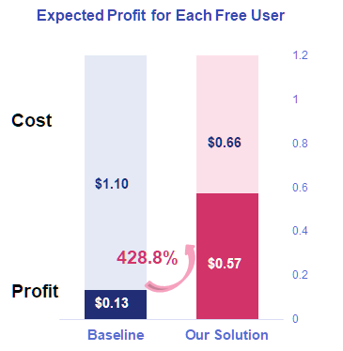
Our Solutions
New predictive model to predict potential premium customers with 40% lower cost per customer.
Accurate customer targeting strategy to make 429% more profit per customer.
Marketing plan focusing on selected features to improve user experience and engagement.
Notes:
Our model makes more money. Using this model to select highly potential premium users for next campaign, we should see a 40% lower cost and a 429% more profit on each customer, compared with the original strategy without selection.
The interesting features we’ve included in the model will help company understand customer behaviors, and design the marketing plan that can improve user experience and engagement.

Slide 4
Business Model:- Premium Users Bring Revenue But...
Previous Data
Targeted campaigns to increase the premium user adoption rate
Low conversion rate, Less Opportunities
Based on reporting data,
ARPPU as $34.36 → Lost Revenue if not predicted an potential adaptor correctly
Avg Advertising Cost $1.14 → sunk cost if
wrongly predictor a non-adaptor
Performance Metric:- Higher cost for missing a potential premium user, less cost for identifying a false positive, hence best model will have lower overall cost function
41,540 Marketed Users
1540
Adopters
3.7%
Adoption Rate
Notes:
Here reporting data shows that we as company analysts have taken our own historical reporting and calculated our ARPPU [Average revenue per paying user]. For this assignment, we have taken data from spotify, paypal etc. and have come up with these numbers.

Slide 5
Analysis
Relevant Feature Selection
11 features out of 27
(Age, Friends, Track Loved, Premium Friends, Playlist etc.)
Select Models
Test Models
Evaluate Performance
KNN models with K 5,6,7
Naive Bayse
Decision Tree
Logistic Regression
Testing is conducted
Same dataset to test models.
Performance on cost metric
Notes:
Analysis:
To give a brief introduction of how the analysis is conducted and relationship with the findings.

Slide 6
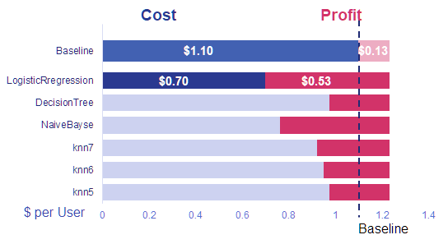
Findings
Logistic regression model is our best model, with the lowest cost thus highest profit for each free user we have.
Testing With Separate Data
41.5%
Free Users
8308
Total
3444
Chosen by Model
Subscribers
7.3%
55
Left Out
253
Targeted
7.3% Response Rate, Compared to 3.7% when targeting all users
Notes:
Findings:
Logistic regression model is the best model
We find 4 features.
Script:
After training and testing the 6 models, we found that the logistic regression shows the best performance,
by the metrics we chose that maximize the profit.
This is a commonly used model that gives different weights to features and output a probability
To test the performance of this model, we also used a separate dataset to simulate and evaluate the strategy
As shown on the right, our test set contains 8308 free users from our historical data.
Our model chose 41.5% of them as the target, out of which 253 accepts the offer and converted to subscriber.
Which stands for 7.3% of response rate in our offers, doubled from the 3.7% we would get if we target all free users
Although by doing so, our model missed out 55 potential users that could be converted otherwise, but saved more than half of the cost, thus making four times of profit compared to before.

Slide 7
Findings
Features Used by the Logistic Regression Model
Number of Friends The Current User Has
Total Number of Different Songs User “liked”
Number of Playlists Created by The User
Number of Friends Who Are Premium Subscribers
Total number of Posts and that created in 3 months
Number of liked Songs within 3 months
Notes:
This model uses 7 features in total, including aspects like number of friends, songs liked, playlists created, posts made, ect.
Which means that the model looks at different perspectives of information about a user and summarize them to inform whether we should target the user or not.

Slide 8

Recommendations
Focus on specific features and apply the Logistic Regression Model to locate potential subscribers to achieve greater profit.
Adjust the company strategy to create more potential subscribers.
Build better community, encourage users to
open network and connect with others
leave out comments and “LIKE”
create and share exclusive playlists
Discount for group subscribe
Reward for numbers of songs listened
Notes:
Recommendations:
After the rigorous analysis, we now focus more on what XYZ need to do in short and long term to further achieve greater profit.
Based on the analysis, XYZ should Focus on specific features and apply the Logistic Regression Model to locate potential subscribers and send advertisements to them to achieve higher profit.
To maximize long term profit and keep utilize and improve the model, we highly recommend XYZ to adjust the company strategy to create more potential subscribers.

Slide 9
Summary
Predictive modeling
Cost Minimization
Feature selection
Logistic Regression Model
Business insights
Apply LR model to maximize the advertising profit
Adjust the company strategy to create more active and loyal users.
Notes:
Summary (Summarize and conclude by restating how your Better Than Before solution addresses the business problem and improves the situation)

